Slide 1
Project 1
Anna Howitt
Feb 2024

Slide 2
Superstore Dataset
Problem Statement: The Regional Sales Director wants to understand the impact of returns and discounts on the profits of specific products in Furniture and Office — in the central United States in 2019.
Goals: To gain an understanding on the relationships between returns, discounts, and profits of Furniture and Office products and their impact on the business. This will allow the Regional Sales Director to take the best approach of applying strategies to reduce returns, enhance sales, and increase profit margins.

Slide 3
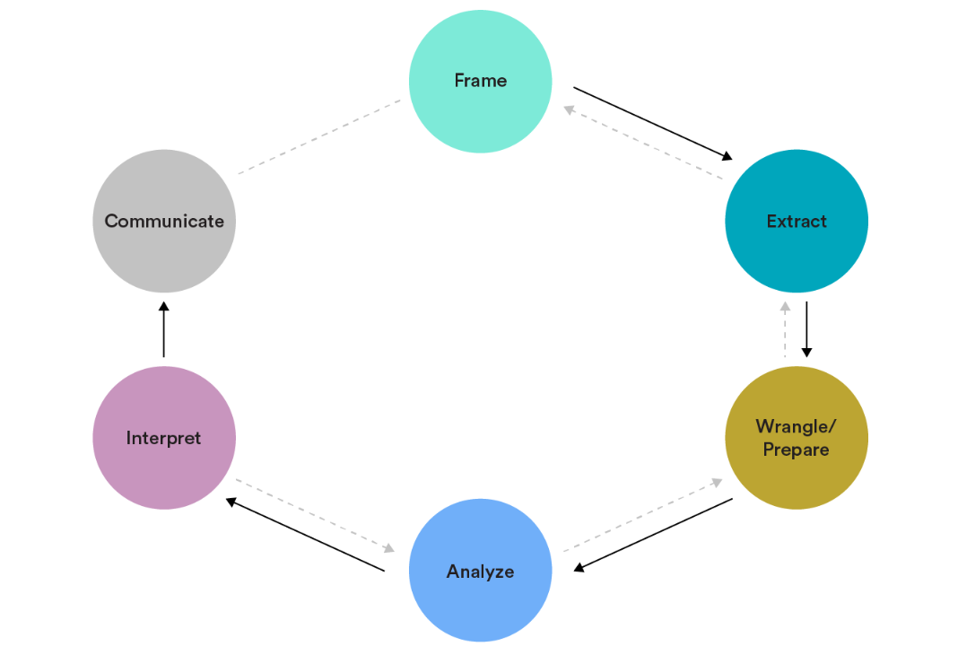
Data Analytics Workflow
Frame: Problem statement
Extract: Superstore Dataset – system/software generated
Wrangle/prepare: Cleaning the data as appropriate – remove duplicates, profit margin calculation to complete fields.
Analyse: Graphs and chart visualisations to summarise data
Interpret: The reasons for these findings, recommendations.
Communicate: Present findings to intended audience; Key stakeholder

Slide 4
Total of Orders
Highest orders were for binders (Office Supplies) and lowest was Tables (Furniture)

Slide 5
Customer Segment
Consumers purchase the most goods. Each segment will have unique needs, preferences, and behaviours.

Slide 6
Number of Orders and Returns
Weak positive correlation between order quantities and number of returns

Slide 7
Profit and Discount
Row Labels | Sum of profit | Average of discount
Bookcases | £1,862.30 | 37.06%
Chairs | £3,097.15 | 32.49%
Furnishings | £813.90 | 22.78%
Tables | -£313.86 | 35.87%
Appliances | £127.99 | 46.95%
Art | £968.46 | 27.24%
Binders | £1,028.13 | 27.74%
Envelopes | £1,446.94 | 17.16%
Fasteners | £392.81 | 16.55%
Labels | £1,710.90 | 16.76%
Paper | £964.28 | 17.65%
Storage | £2,824.48 | 22.25%
Supplies | £587.60 | 21.30%

Slide 8
Profit and Returns
Row Labels | Sum of profit | Sum of return quantity
Furniture | £5,459.49 | 279
Bookcases | £1,862.30 | 63
Chairs | £3,097.15 | 80
Furnishings | £813.90 | 107
Tables | -£313.86 | 29
Office Supplies | £10,051.59 | 758
Appliances | £127.99 | 28
Art | £968.46 | 102
Binders | £1,028.13 | 191
Envelopes | £1,446.94 | 59
Fasteners | £392.81 | 47
Labels | £1,710.90 | 84
Paper | £964.28 | 81
Storage | £2,824.48 | 103
Supplies | £587.60 | 63

Slide 9
Reasons for Returns

Slide 10
Results
The low-profit Furniture and Office products commonly had a higher average discount but with lower returns. In contrast, the high-profit products had more returns than the low-profit products, but the discounts varied.
Recommendations:
There was a high number of wrong items being delivered which will reduce customer satisfaction. Refining customer service processes and operational efficiency will help improve service and decrease returns.
Modifying pricing tactics and optimising product offerings to increase profitability.
Targeting specific customer segments such as consumers who make up the majority of sales or increase corporate customers by targeting strategies by tailor marketing efforts and promotions precisely to these segments to increase sales without relying heavily on discounts.

Slide 11
Further Investigation…
Evaluating the effectiveness of different discount strategies.
Looking deeper into customer segments impact and how regions impact profits.
Which products are bought more in bulk and how this effects customer satisfaction and profitability.
Seasonality or Trends - depending on the customer segment or product category, there could be seasonal factors or trends influencing both order quantities and return rates.

